Slide 1
Network and Server Security Essentials
Presented by Hansen Wu

Slide 2
Overview
Basic Networking and Terminology
The Simple Server
SSH and Bash Commands
Proxies
Securing a Server

Slide 3
Basic Networking and Terminology
This will be a bit dry...

Slide 4
IP Address

Slide 5
Internet Protocol Address
IPv4
4 blocks of 8 bits, 32 bit total
2^32 = 4,294,967,296 total addresses
IPv6
Be future ready and prepare for IPv6
8 groups of 4 hexes, 2^128 total addresses
Subnetting
I.e. 192.168.1.0/24 is all possible IPs with last block as wildcard
Calculating bits
Google is your friend

Slide 6
Port

Slide 7
Port
Logical construct
Assigned to inbound/outbound packets
Ranges up to 65535
1024 reserved well known ports
Non enforced conventions
21: FTP
22: SSH
80: HTTP
443: HTTPS
990: FTPS

Slide 8
Proxies

Slide 9
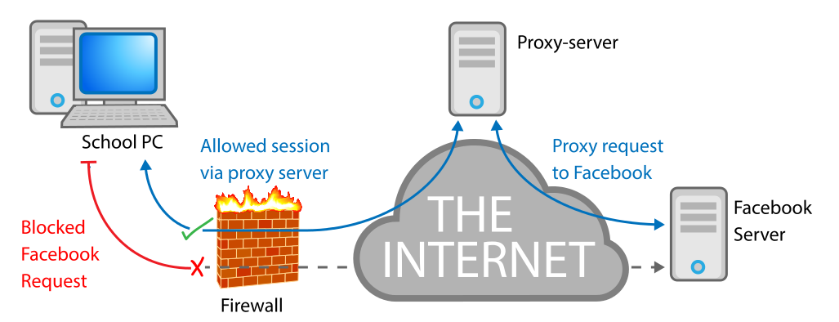
Proxies
Think back to history class: proxy wars
“intermediary for requests from clients seeking resources from other servers”
Hides yo ass
Reverse proxy: important for orgs for load balancing, caching, privacy, and more

Slide 10
VPN

Slide 11
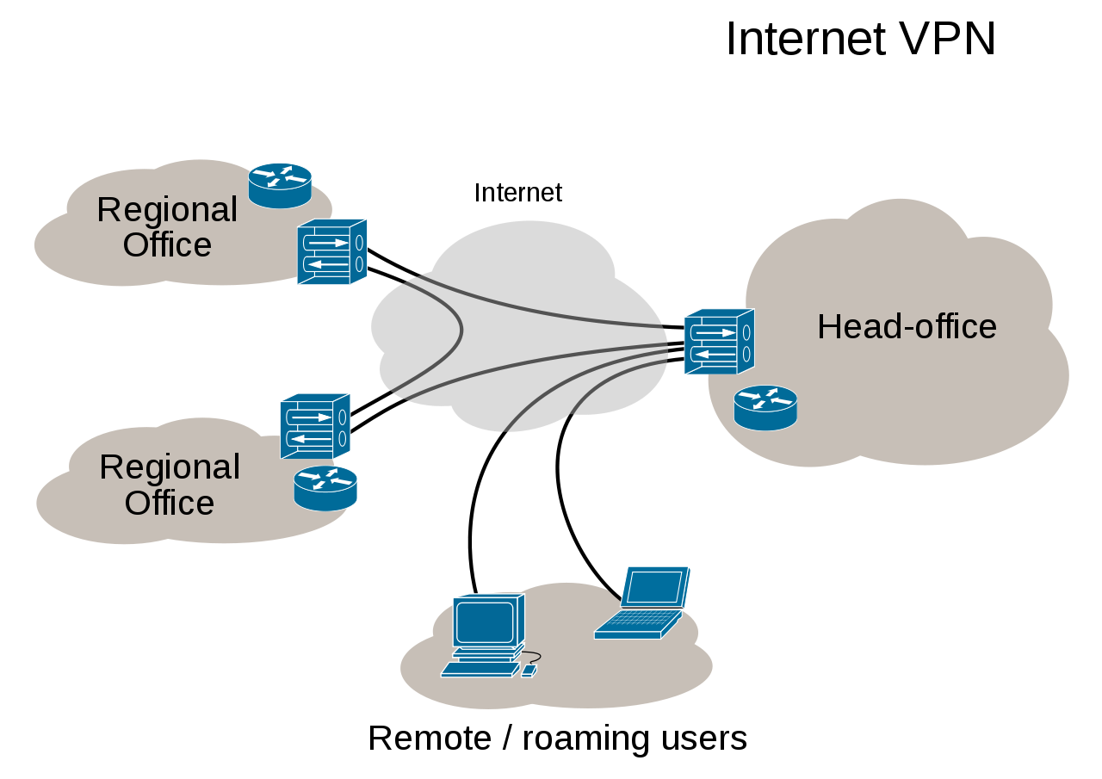
Virtual Private Network
Virtualized network extending beyond physical limitations network
“extends a private network across a public network”
Can connect to a network and access intranet resources remotely and securely
All traffic sent through vpn
DNS leaks

Slide 12
DNS

Slide 13
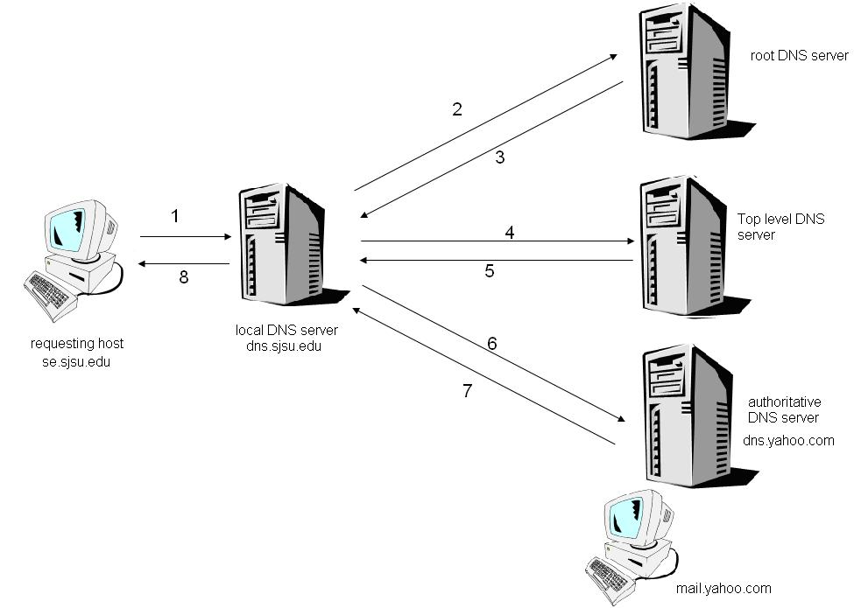
Domain Name System
Provides directions for network requests
Database associating domain names and other information with IP addresses
Useful for servers on dynamic IPs

Slide 14
The Simple Server

Slide 15



Build your own server
Web and SSH Linux stack
Host a website
Remote access
Limitless expansion options

Slide 16
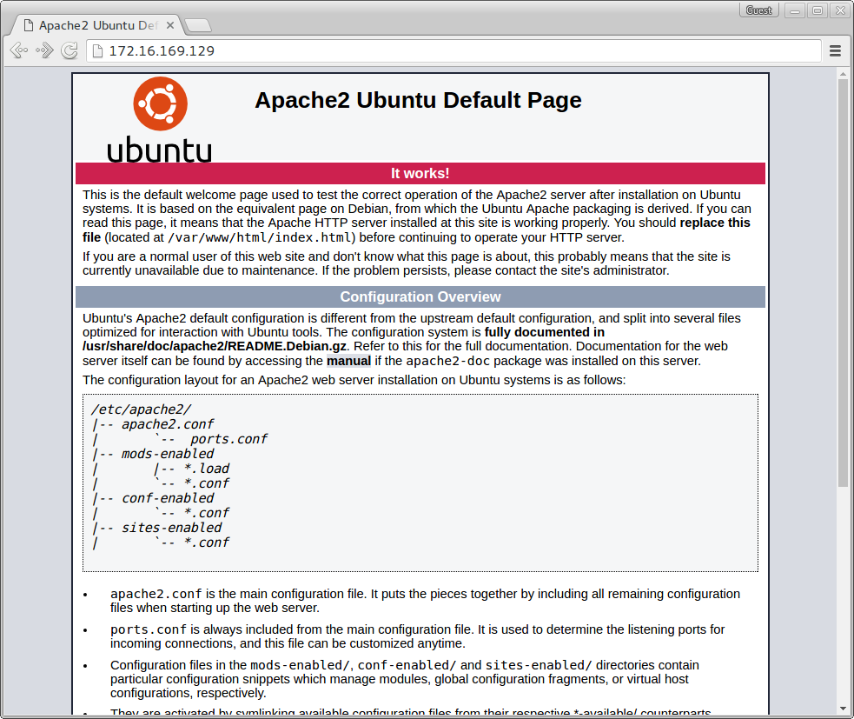
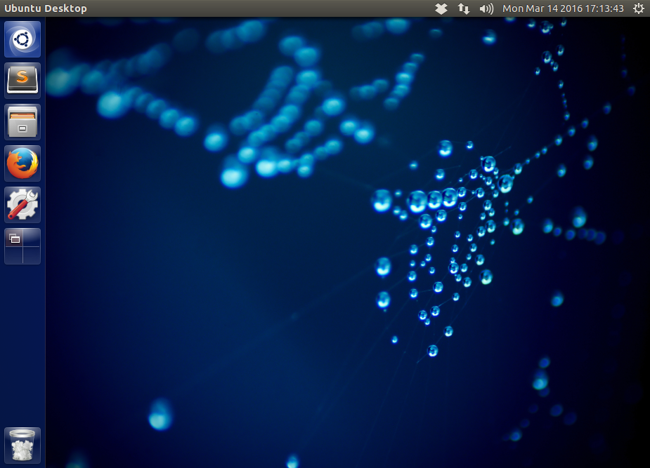
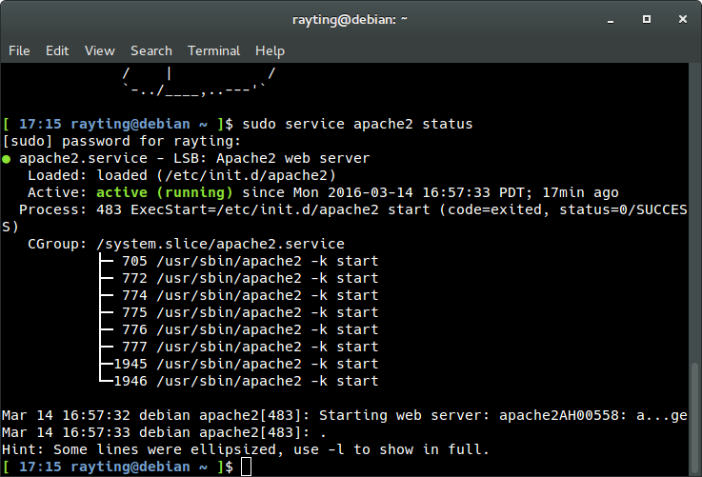
Demonstration!

Slide 17
SSH and Bash Commands

Slide 18
Linux or: How I Learned To Stop Worrying and Love the Command line
Try out some Bash commands!
Powerful network tools and capabilities
telnet
nc
curl
wget
ssh

Slide 19

Demo!

Slide 20
Proxies

Slide 21
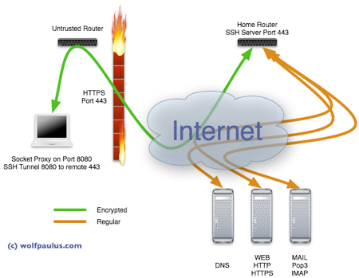
Proxies
Recap: accessing network through another machine
Wide range of uses
Bypass region limitations
Defeat censorship and firewalls
Security in an unsecure environment

Slide 22
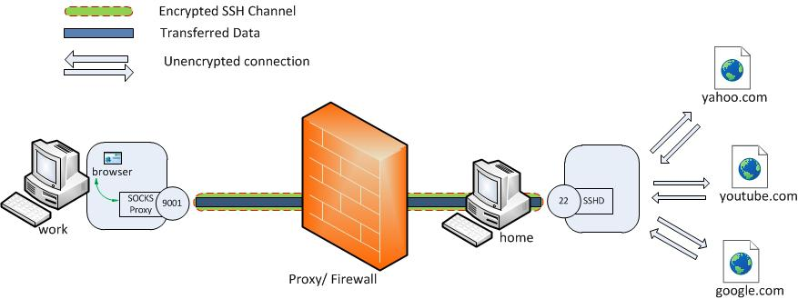
Demo!

Slide 23
Server Security

Slide 24
Opening the Floodgates
Sheltered and protected environment behind the router
Router blocks most malicious traffic
Enabling external access and port forwarding
Attacks start the second you “open the door”
Very well known and documented botnets bruteforcing SSH
https://blog.sucuri.net/2013/07/ssh-brute-force-the-10-year-old-attack-that-still-persists.html
root login, dictionary attack

Slide 25
Protective Measures
SSH
Root login
Certificate access
fail2ban
Visual fingerprint
Fail2ban
Ban duration
Attempts
Apache
Index only, 403 your resources

